Slide 1
Git’n Pro with HTML/CSS
Day 2
Apr 20, 2016
Notes:
Moving quickly tonight

Slide 2
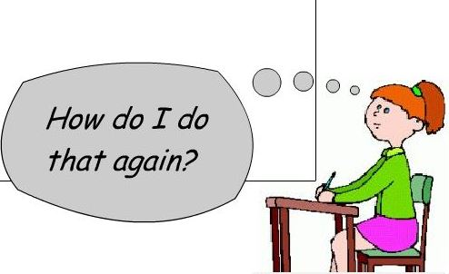
It’s Okay!
Notes:
Things move fast but the material is saved and available for reference

Slide 3
Admin Items

Slide 4
Where to Get Help
Practice, Practice, Practice: Work Individually or in Groups
Review In Class Material (Exercises and Slides): https://github.com/the-Coding-Boot-Camp-at-UT-Austin/04-16-Class-Content/tree/master/0418-mw-class-content
Re-Watch Class Videos: https://codingbootcamp.hosted.panopto.com/Panopto/Pages/Viewer.aspx?id=432c216e-b7ef-41c5-8b50-5933109a3c71
In Class Office Hours: 45 minutes before class, 30 minutes after
One-on-One Sessions: By Announcement through SSM
Contact Student Success: Anytime!
Notes:
Watching videos is great but actual coding is the best practice you can do.

Slide 5
Homework #1 - Assignment
Also, at this point everyone should have access to the homework repository in GitHub. https://github.com/the-Coding-Boot-Camp-at-UT-Austin/04-16-Class-Content/tree/master/homework-assignments
Homework Assignment #1 is due next week
MW Class: Next Wednesday (4/27)

Slide 6
Today’s Class!

Slide 7
Today’s Objectives
Students will understand the importance of Git Version Control and how to use it
Students will create GitHub Repositories, push code into them, and share with class
Students will make more HTML documents
Students will learn to properly use basic HTML tags
Students will implement basic CSS styling to HTML documents.

Slide 8
Know Thyself
If you are a complete beginner to HTML/CSS and Coding…
Continue getting comfortable with HTML.
Be able to completely write a basic HTML document (like in last class)
Understand what CSS is, what its for, and how it works with HTML
********** Be able to use Git and GitHub to upload code
If you’ve had past exposure and felt comfortable with the last lesson…
Aim to build up your skills. Clear up questions or confusions about HTML
Become knowledgeable about a wider range of HTML and CSS tags
Be able to selectively apply CSS to specific HTML elements
********* Be able to use Git and GitHub to upload code.

Slide 9
What / Why Git?

Slide 10
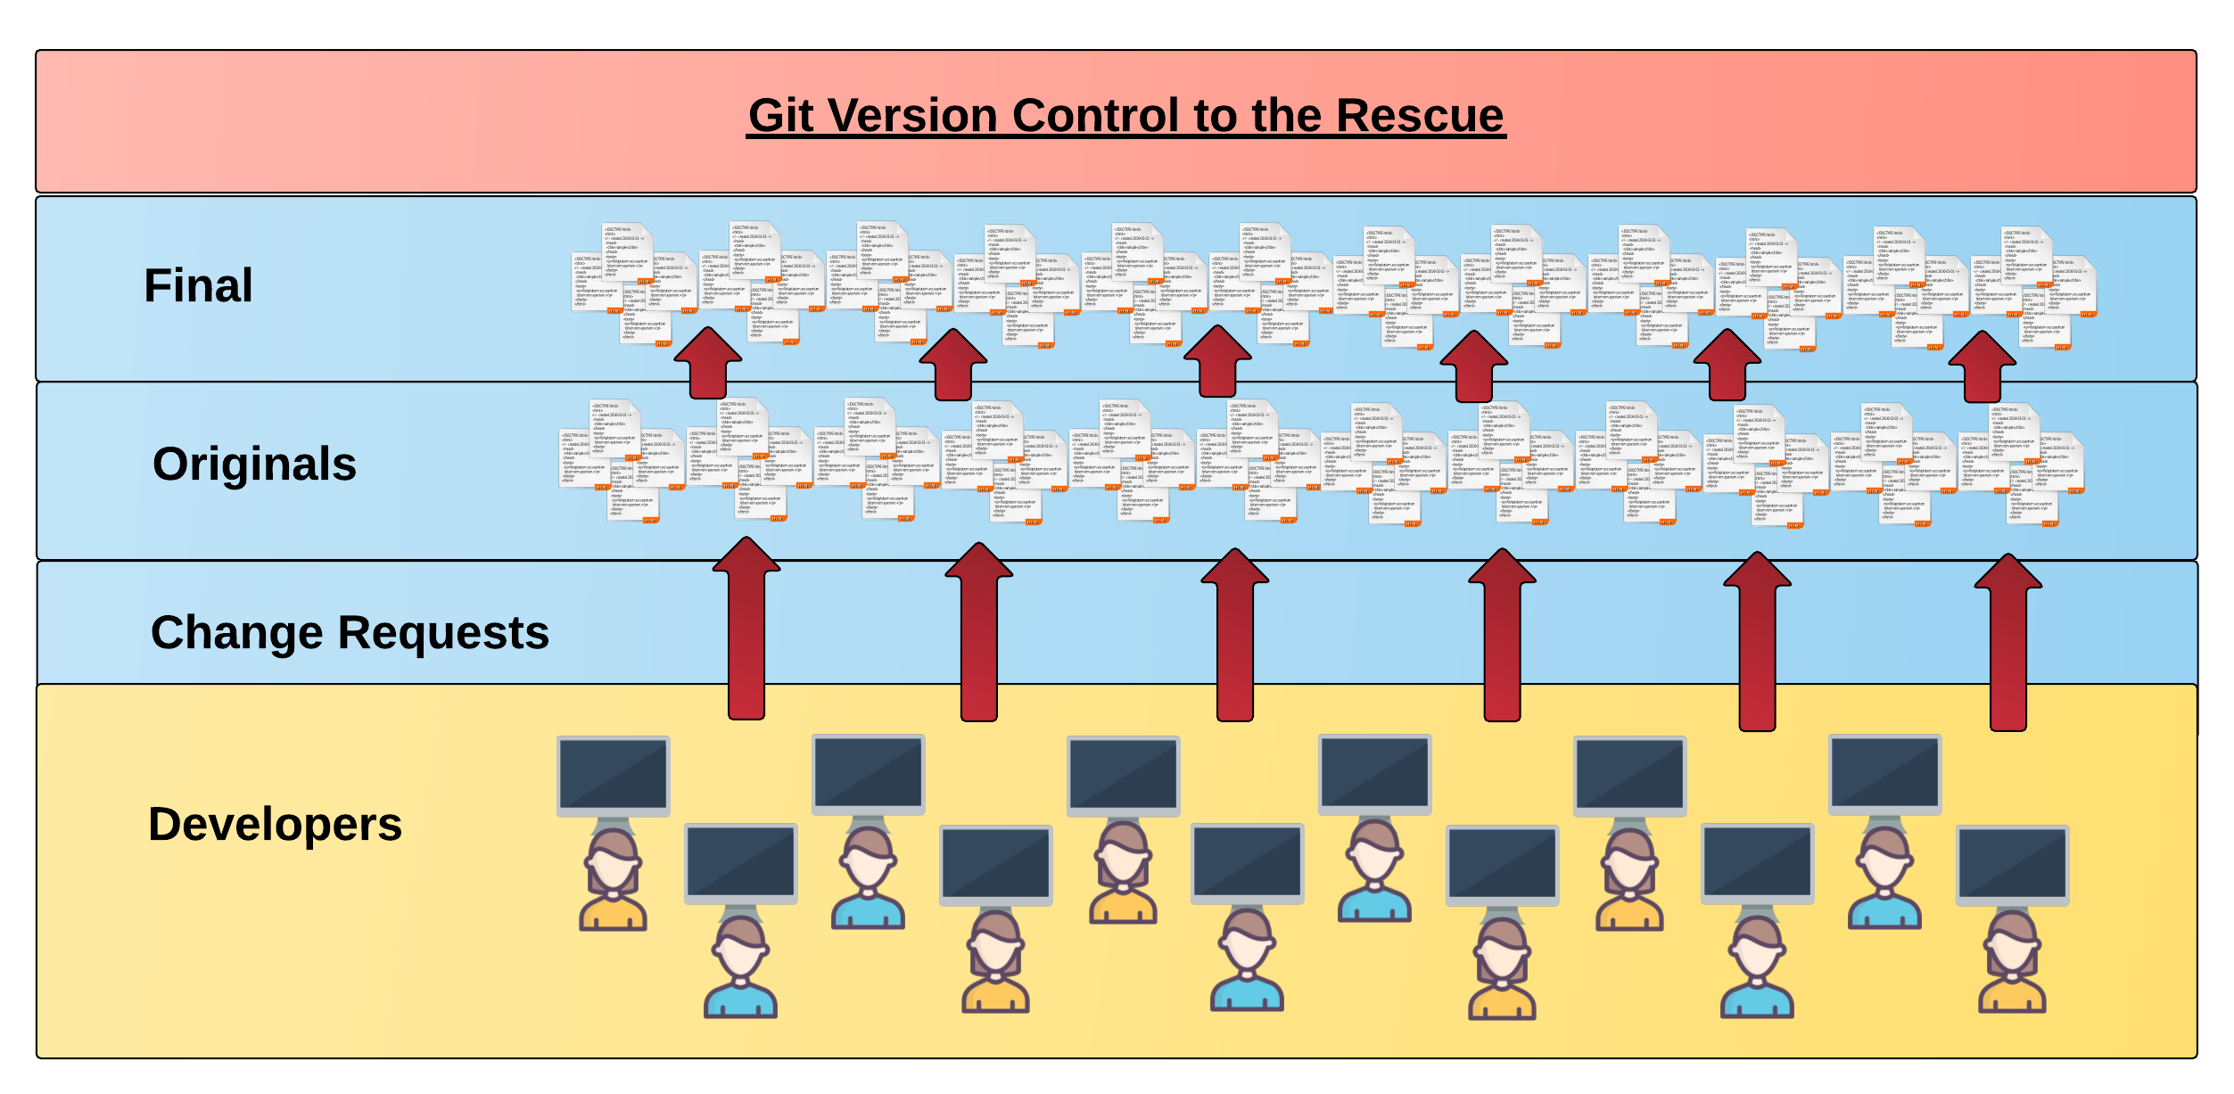
Collaborative Coding
Modern web development is highly collaborative.
Teams are often extremely large and separated across country (or planet).
Applications are often made up of hundreds or thousands of files.
Notes:
It is this complexity that lead to the need for a version control system like git

Slide 11

The Group Project
OMG. I HAZ THE GREATEST HTML IDEA!!!!!
SpongeSite.com

Slide 12

The Group Project
Programming Away…

Slide 13

The Group Project
Programming Away…
Spongebob’s idea is dumb. We should call it…
PrincezzzSite.com

Slide 14
The Group Project
Programming Away…
Spongebob’s Version
Programming Away…
Prince’s Version

Slide 15
The Group Project
The Group Project – Tragedy #1
Programming Away…
Now they have two completely different versions.
Programming Away…

Slide 16
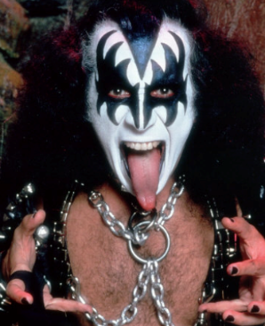
The Group Project
Programming Away…
Programming Away…

Slide 17
The Group Project
Programming Away…
Hai guyz!!!
How R Kan help??
Programming Away…

Slide 18
The Group Project – Tragedy #2
Programming Away…
OK.
Delete. Delete. Delete. Delete.
Delete. Delete
Programming Away…

Slide 19
The Group Project
Lesson:
You should use Version Control.
….And be wary of group members.
Notes:
When we collaborate it is important to have version control, not just changes to the code but the ability to revert back in case something breaks on a new piece of code. Of course you want to have a strong testing regime along with proper development, staging and production servers. But the version control alone is an important step.

Slide 20
Version Control
Git Version Control: Offers a set of commands and an organizational structure for managing code when multiple developers work simultaneously.
Major Benefits come from using Git:
Code Conflict Resolution
Version History

Slide 21
The Group Project
The Group Project – Tragedy #1 (Revisited)
Programming Away…
Now they have two completely different versions.
Programming Away…

Slide 22
The Group Project
The Group Project with Version Control
Main Branch (Spongebob’s)
Spongebob continues programming
1
2
3
4
5
Prince pushes (uploads) his code changes into the main branch.
Code conflicts are resolved before inclusion.
Prince’s Branch

Slide 23
The Group Project – Tragedy 2 (Revisited)
Programming Away…
OK.
Delete. Delete. Delete. Delete.
Delete. Delete
Programming Away…

Slide 24
The Group Project with version control
Main Branch (Spongebob’s)
1
2
3
4
Gene pushes his (bad) code deletions
Gene’s Branch

Slide 25
The Group Project with version control
Main Branch (Spongebob’s)
1
2
3
4
5
But this time, Spongebob rolls back the code to an earlier version.
Kiss Dude’s Branch
Notes:
Gene’s branch can still exist, maybe he can take another crack at whatever he was trying to accomplish and push again. If it fails then SB can revert once more without affecting his productivity.

Slide 26
The Group Project
Lesson:
You should use Version Control!

Slide 27
Quick Activity!
Turn to your neighbor and have one of you explain to the other:
What the concept of version control is
Then the other should explain :
Two of the key advantages to using a version control system

Slide 28

So… What’s this GitHub?
GitHub is a Web-Based hosting service to store code online.
It allows developers to pull (download) code or push (upload) code to the same repository (directory).
It also allows developers to view histories of code changes and track issues.
Notes:
Octocat, Simon Oxley - http://www.idokungfoo.com/ -

Slide 29



Pushing and Pulling to GitHub
1
2
3
4
GitHub Branch
Pull Code
Push Code
Pull Code
Push Code
Pull Code
Push Code

Slide 30
Get Started with Git

Slide 31
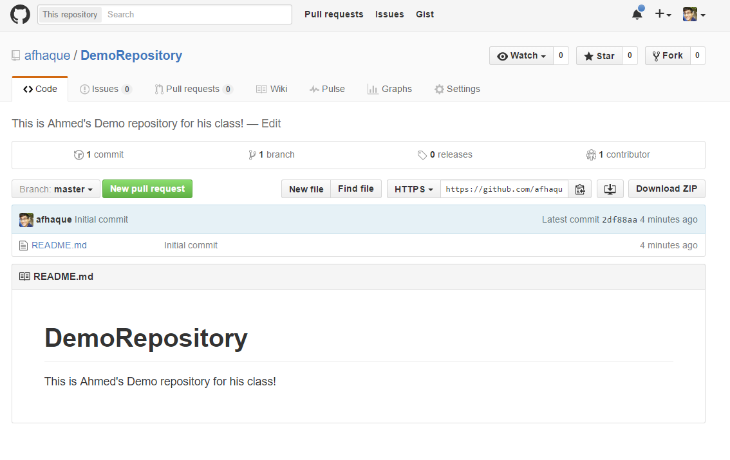
Instructor Git Demo!
Notes:
Instructor do – create new repo, make sure to force git to create the folder.

Slide 32
Basic Git Commands
At its most basic, these are the five git commands to get started
git clone
git add
git commit
git push
git pull

Slide 33
Basic Git Commands
At its most basic, these are the five git commands to get started
git clone – copies an entire repo (to begin)
git add – adds a file for inclusion in Git
git commit – notes a change to the local repo
git push – sends changes to hosting service
git pull – downloads freshest version of repo
Notes:
Lots of other commands can be found at

Slide 34
> YOUR TURN!
Assignment:
Using GitHub and the Command Line:
Create a new public GitHub repository and name it whatever you like. Be sure to check the box for “initialize this repository with a README”
Next, clone the repo to your local directory.
Then create an HTML file inside the local directory.
Add, Commit, and Push the code to GitHub.
Bonus:
Find a partner in class and fork their repository to your own GitHub account. Clone this forked repository to your local directory.
Add, Commit, and Push the code back to your forked copy.
Finally, submit a pull request to send your changes to your partner’s repo.

Slide 35

Still a Bit Lost? Never Worry!
Follow this handy Guide!
Practice a few times on your own before our next class.

Slide 36
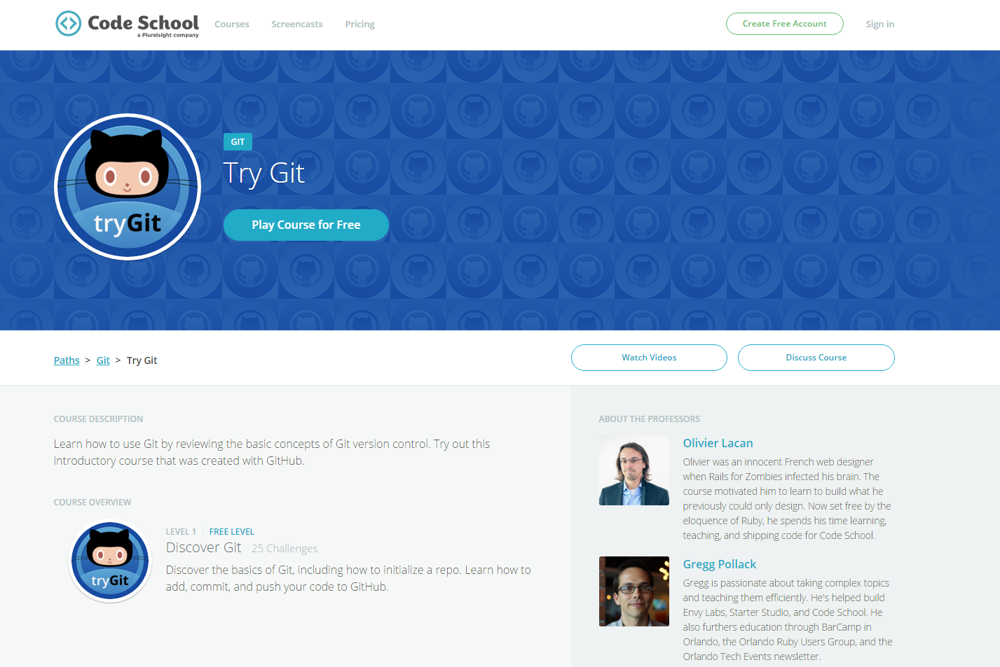
If You’re Still Lost… Here’s a (Free) Course
https://www.codeschool.com/courses/try-git

Slide 37
HTML Round 2

Slide 38
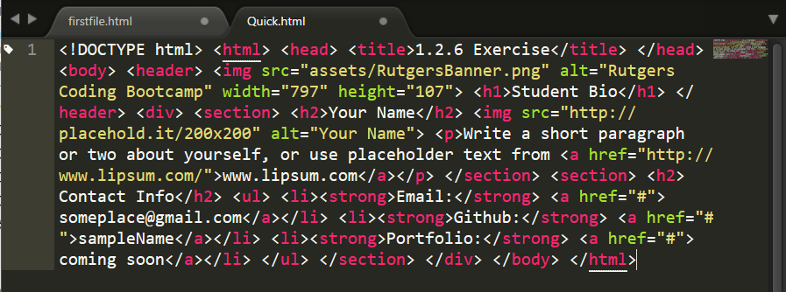
On Ugly HTML
Don’t do this… Use proper indentation and sectioning.
Readable code is easier to maintain.
Invest time to get better about this now. It will pay dividends!

Slide 39
HTML Syntax (Basic)
Content
<h1>
This is Mah House
</h1>
Opening Tag
Closing Tag

Slide 40
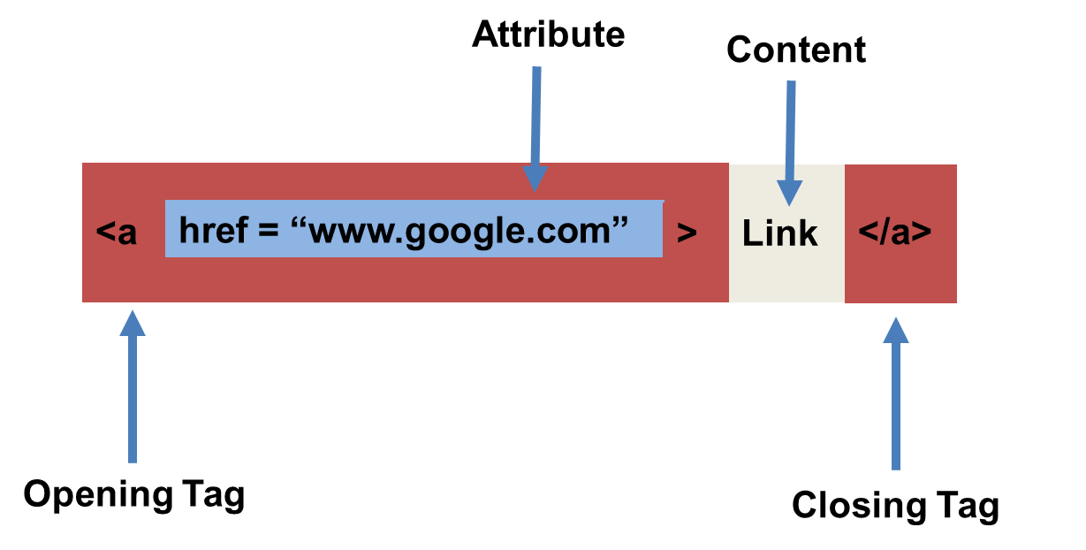
HTML Syntax (with Attribute)

Slide 41
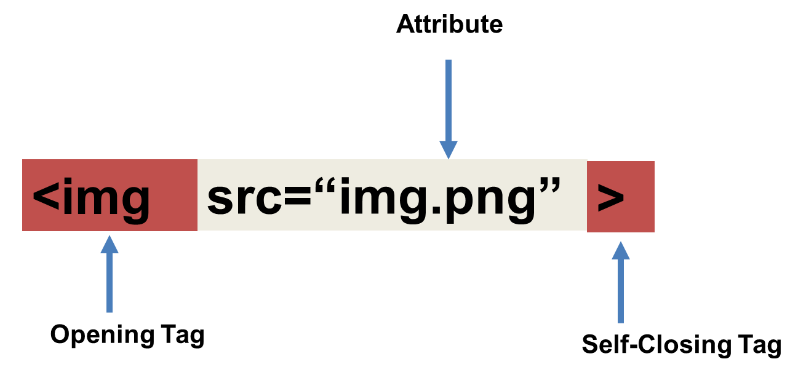
Tricky Tags (Self-Closing)
Notes:
Last class I was adding a trailing slash out of habit, this is not needed for Void Tags or tags without content. As shown here. Trailing slashes are required on your code if you are just creating snippits (small chunks of code that don’t allow you to set the head or doctype tags) and don’t know where or how your pieces may be added. Feel free to google Xhtml VS HTML5 to get an idea of the times when a trailing slash may be required.

Slide 42
Important Common Tags
Headers:
<h1> </h1> - Header 1 (Largest Header)
<h2> </h2> - Header 2 (Next Largest Header)
<h3> </h3> - Header 3
…
Containers:
<html> </html> - Wraps the entire page
<head> </head> - Wraps the header of the page
<body> </body> - Wraps the main content
<div> </div> - Logical Container ***
<p> </p> - Wraps individual Paragraphs
Others:
<strong> (bold), <em> (emphasis)
<img> (images), <a href> (links), <li> (list items) , <title> (title), <br> (line break), <table> (tables), <!-- --> (comments)

Slide 43
Less Common Tags
All HTML Tags are listed here: http://www.w3schools.com/tags/
Don’t try to memorize them! Simply refer back to documentation as needed.
Other tags:
<video> for Videos
<audio> for Audio files
<embed> for Embedded files
<code> for including computer code
<header> for headers
<nav> for navigation bars
<footer> for footers

Slide 44
HTML for Forms
Common UI (User Interface) Form Elements:
<form> - Creates a form section in HTML
<input> - Input boxes
<label> - Labels for boxes
<button> - Button
<textarea> - Large textbox

Slide 45
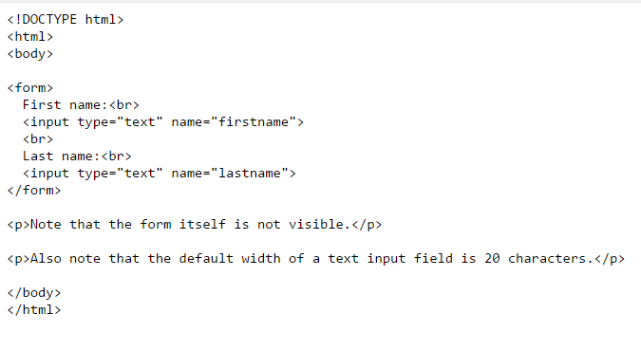
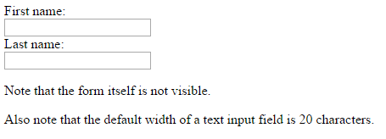
HTML for Forms

Slide 46
> YOUR TURN!
Assignment
In this activity, you’ll be creating a student bio using HTML. You will then add, commit, and push your completed HTML to GitHub for the world to see.
Additional instructions, sent via Slack.

Slide 47
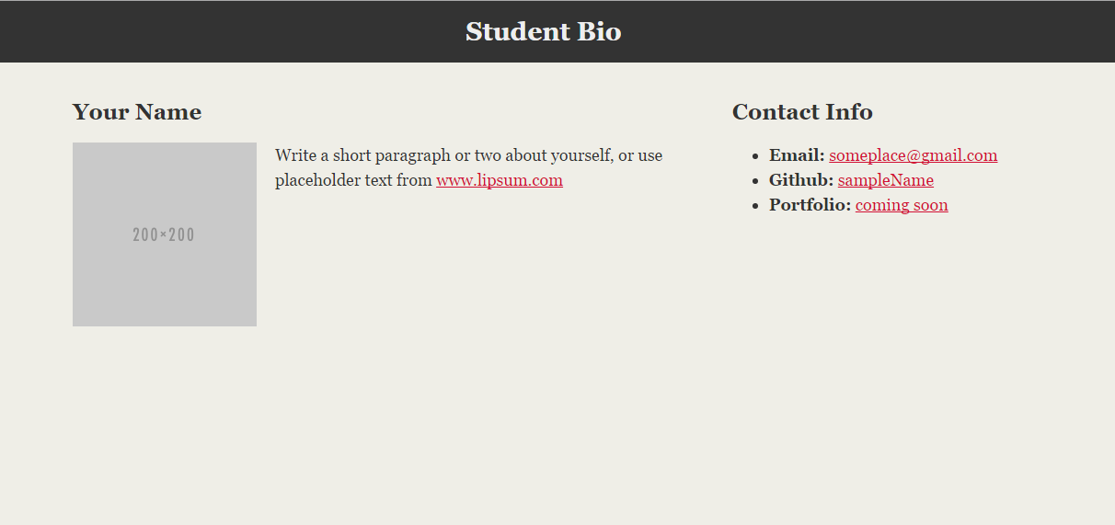
> YOUR TURN!

Slide 48
CSS Stylin’

Slide 49


HTML / CSS Definitions (*yawn* unimportant)
HTML: Hypertext Markup Language – (Content)
CSS: Cascading Style Sheets – (Appearance)
HTML/CSS are the “languages of the web”. Together they define both the content and the aesthetics of a webpage – handling everything from the layouts, colors, fonts, and content placement. (Javascript is the third – handling logic, animation, etc.)
Notes:
The idea is separate the concerns. HTML is kept separate from style or what is often called presentation. HTML – is the content with tags that “describe the content” CSS – is the presentation, how the elements are styled/appear. Keeping the separation ensures best development and graceful degradation. WORST CASE – html only and life is still OK because I have my content.

Slide 50


HTML / CSS Analogy
HTML Alone
Like writing papers in “Notepad”.
Can only write unformatted text.
HTML / CSS
Like writing papers in Microsoft Word.
Can format text, page settings, alignment, etc. based on “highlighting” and menu options.

Slide 51
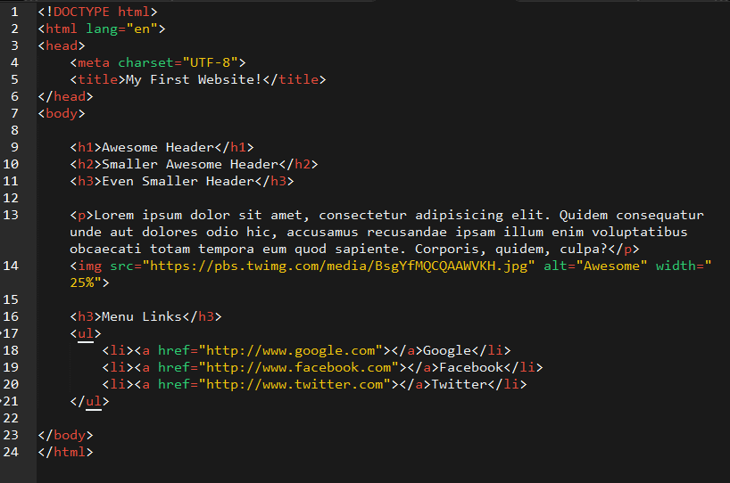
Basic HTML Page

Slide 52

Basic HTML Page - Result

Slide 53
Basic HTML Page - Result
Hella Boring…

Slide 54
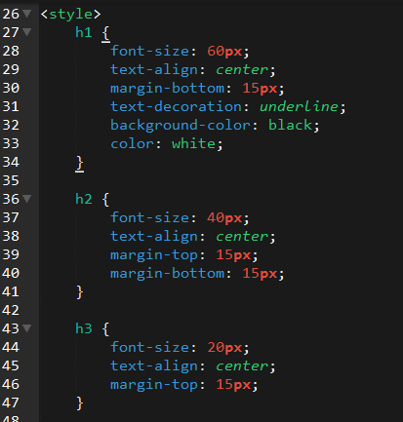
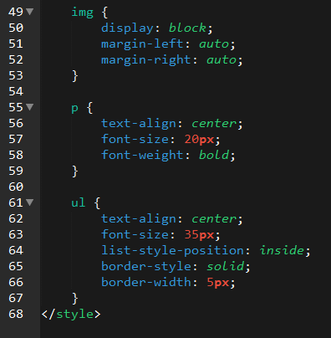
Enter CSS

Slide 55

Enter CSS - Result

Slide 56

CSS Syntax
CSS works by hooking onto selectors added into HTML using “classes and identifiers”.
Once hooked, we apply styles to those HTML elements using css .

Slide 57
CSS Example
In the below example the “Header” would be turned blue and MUCH larger, because of the CSS.
If we’d like to apply a CSS style selectively, we can incorporate a class or ID. Just remember to include the necessary symbol (. or #) before the css.
Example (HTML):
<p class=“bigBlue”>Header</p>
Example (CSS):
.bigBlue
{
font-size: 100px;
color: blue;
}

Slide 58
Key CSS Properties
Font / Color:
color: Sets color of text
font-size: Sets size of the font
font-style: Sets italics
font-weight: Sets bold
Alignment / Spacing:
margin-top(bottom/left/right): Adds space between element and its own border.
margin-top (bottom/left/right): Adds space between element and surrounding elements.
float: Forces elements to the sides, centers, or tops
Background:
background-color: sets background color
background-image: sets background image

Slide 59
Powerful Duo
Believe it or not… HTML / CSS is all you need to develop a full-blown rich looking website.
Notes:
Most cases, if you can accomplish what you want with just HTML & CSS that is considered a win and far more elegant, lightweight and universal.

Slide 60
INSTRUCTOR DEMO
Instructor: Demo
(quickexample_internalcss.html | 2-BasicCSS)

Slide 61
> YOUR TURN!
Assignment
In this activity, you’ll be upgrading your previous HTML bio using CSS styles. Once you are done with your changes, you’ll commit and push these changes up to GitHub.
Additional instructions, sent via Slack.

Slide 62
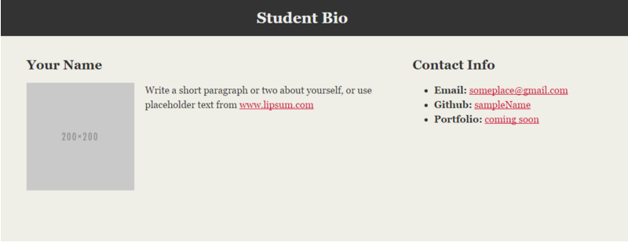
> YOUR TURN!

Slide 63
Recap + Questions
Notes:
Discuss homework -

Slide 64
Know Thyself
If you are a complete beginner to HTML/CSS and Coding…
Continue getting comfortable with HTML.
Be able to completely write a basic HTML document (like in last class)
Understand what CSS is, what its for, and how it works with HTML
********** Be able to use Git and GitHub to upload code
If you’ve had past exposure and felt comfortable with the last lesson…
Aim to build up your skills. Clear up questions or confusions about HTML
Become knowledgeable about a wider range of HTML and CSS tags
Be able to selectively apply CSS to specific HTML elements
********* Be able to use Git and GitHub to upload code.

